Slide 1
Medical Image Generator
Using CLIP and Latent Diffusion
Pruthvi Niranjan

Slide 2
Problem Statement
In dermatology, there is a limited access to a diverse range of dermatological images that represent various skin tones and body areas. This limitation poses challenges in medical training, patient education, and the development of AI models. To address these challenges, there is a need for a system that can generate accurate and representative images of skin conditions, catering to a wide array of skin tones and rash types.

Slide 3
TECHNOLOGY STACK
Frontend: Developed using React to provide an interactive and user-friendly interface for inputting commands and displaying generated images.
Backend: Implemented with Flask to handle API requests and interface with the generative model. It processes user commands and manages data flow.
Model: Utilizes Latent Diffusion Models, which allow for the generation of high-quality images by diffusing a latent variable through multiple steps to achieve realistic outputs.

Slide 4
LATENT DIFFUSION
Latent Space and Noise Process: Latent diffusion involves a diffusion process in a latent space, where noise is gradually added to and removed from data representations to generate or reconstruct samples. This process captures essential data patterns while reducing dimensionality.
Generative Modeling: It is used in generative models to create new data samples that resemble the training data distribution, offering an alternative to methods like GANs by focusing on noise manipulation and reconstruction.
Applications and Advantages: Latent diffusion is applied in image and audio generation, data augmentation, and anomaly detection, providing stable training and high-quality outputs due to its stochastic exploration of data reconstructions.

Slide 5
U-NET
Architecture: U-Net consists of an encoder-decoder structure with a U-shaped network. The encoder path captures context through downsampling (convolutional layers followed by pooling), while the decoder path refines the segmentation through upsampling (convolutional layers followed by transposed convolutions). Skip connections between corresponding layers in the encoder and decoder help retain high-resolution features.
Skip Connections: The U-Net architecture uses skip connections to combine features from the encoder and decoder paths. This helps preserve spatial information and improve the accuracy of the segmentation by integrating low-level features with high-level contextual information.
Applications: U-Net is widely used in medical image analysis, such as tumor detection and organ segmentation, as well as in other image segmentation tasks like satellite image analysis and autonomous driving. Its design enables effective segmentation of images with complex structures and varying sizes.

Slide 6
VAE
Architecture: VAE consists of an encoder that maps input data to a latent space representation (mean and variance) and a decoder that reconstructs the data from the latent representation. The model uses a probabilistic approach to encode the data into a distribution rather than a single point.
Variational Inference: VAE employs variational inference to approximate the true posterior distribution of the latent variables. This is achieved by optimizing a loss function that includes a reconstruction loss (how well the model reconstructs the input) and a regularization term (Kullback-Leibler divergence) that ensures the learned latent space distribution is close to a standard normal distribution.
Applications: VAEs are used in various applications such as generating new data samples, data denoising, anomaly detection, and representation learning. They are particularly useful in cases where capturing complex data distributions and generating diverse, realistic samples is important.

Slide 7
CLIP
Multimodal Learning: CLIP learns to understand and relate images and text by training on a large dataset of image-text pairs. It uses a contrastive learning approach to align images with their corresponding textual descriptions, enabling it to grasp complex associations between visual and linguistic data.
Architecture: CLIP uses two separate encoders—one for images and one for text. The image encoder converts images into feature vectors, while the text encoder converts text descriptions into feature vectors. The model then learns to maximize the similarity between matching image-text pairs and minimize the similarity between non-matching pairs.
Applications: CLIP is versatile and can be used for various tasks such as zero-shot image classification, image search, and text-to-image generation. It can perform tasks without additional training on specific datasets, making it highly adaptable for diverse applications.

Slide 8
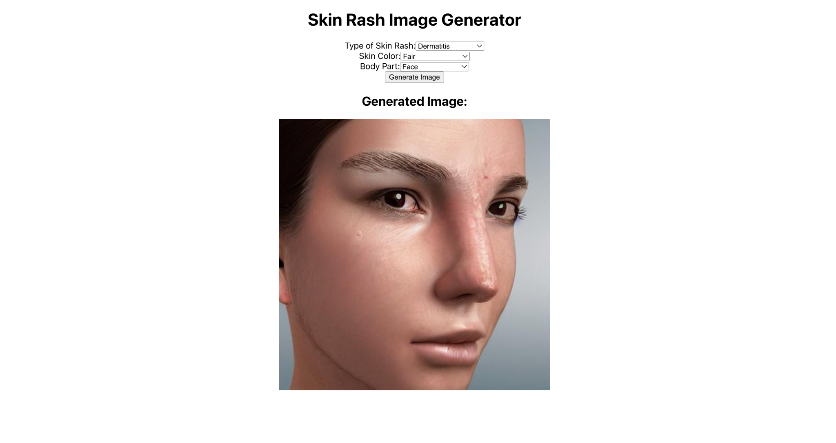
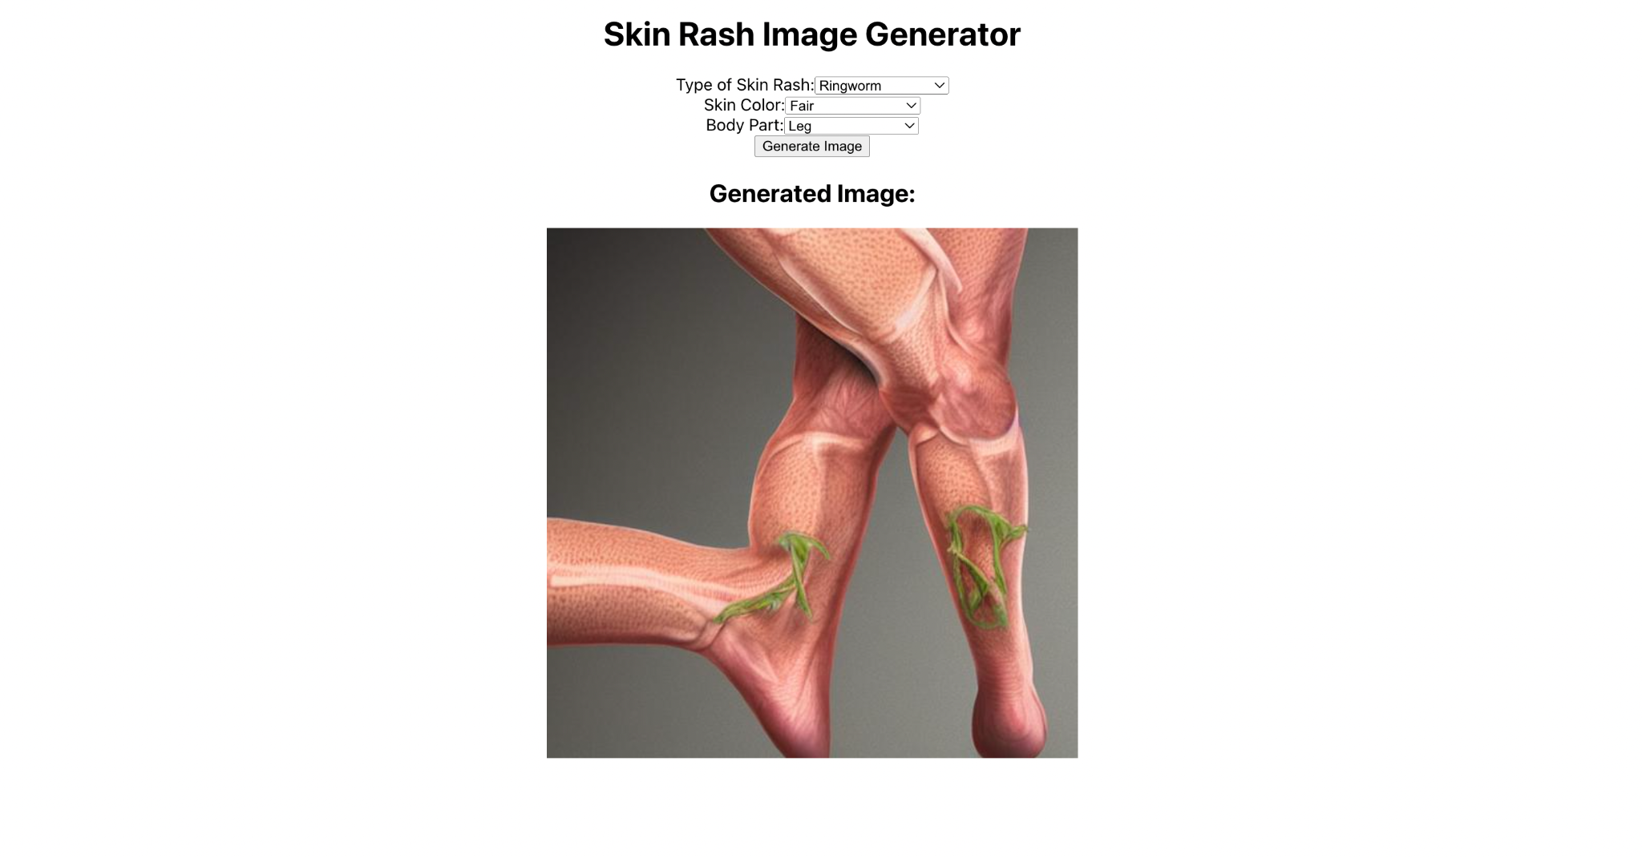
IMPLEMENTATION

Slide 9
Fine Tuning
Pre-trained Models: Fine-tuning starts with a model that has been trained on a large, general dataset (e.g., ImageNet for image classification or a large text corpus for language models). This pre-training helps the model learn useful features or representations that can be applied to various tasks.
Task-Specific Adaptation: During fine-tuning, the pre-trained model is further trained on a smaller, task-specific dataset. This process adjusts the model's parameters to better suit the new task, such as classification of specific types of images or understanding domain-specific text.
Benefits: Fine-tuning reduces the need for extensive training from scratch, saving time and computational resources. It leverages the knowledge acquired during pre-training, leading to improved performance on the new task with relatively smaller datasets.

Slide 10
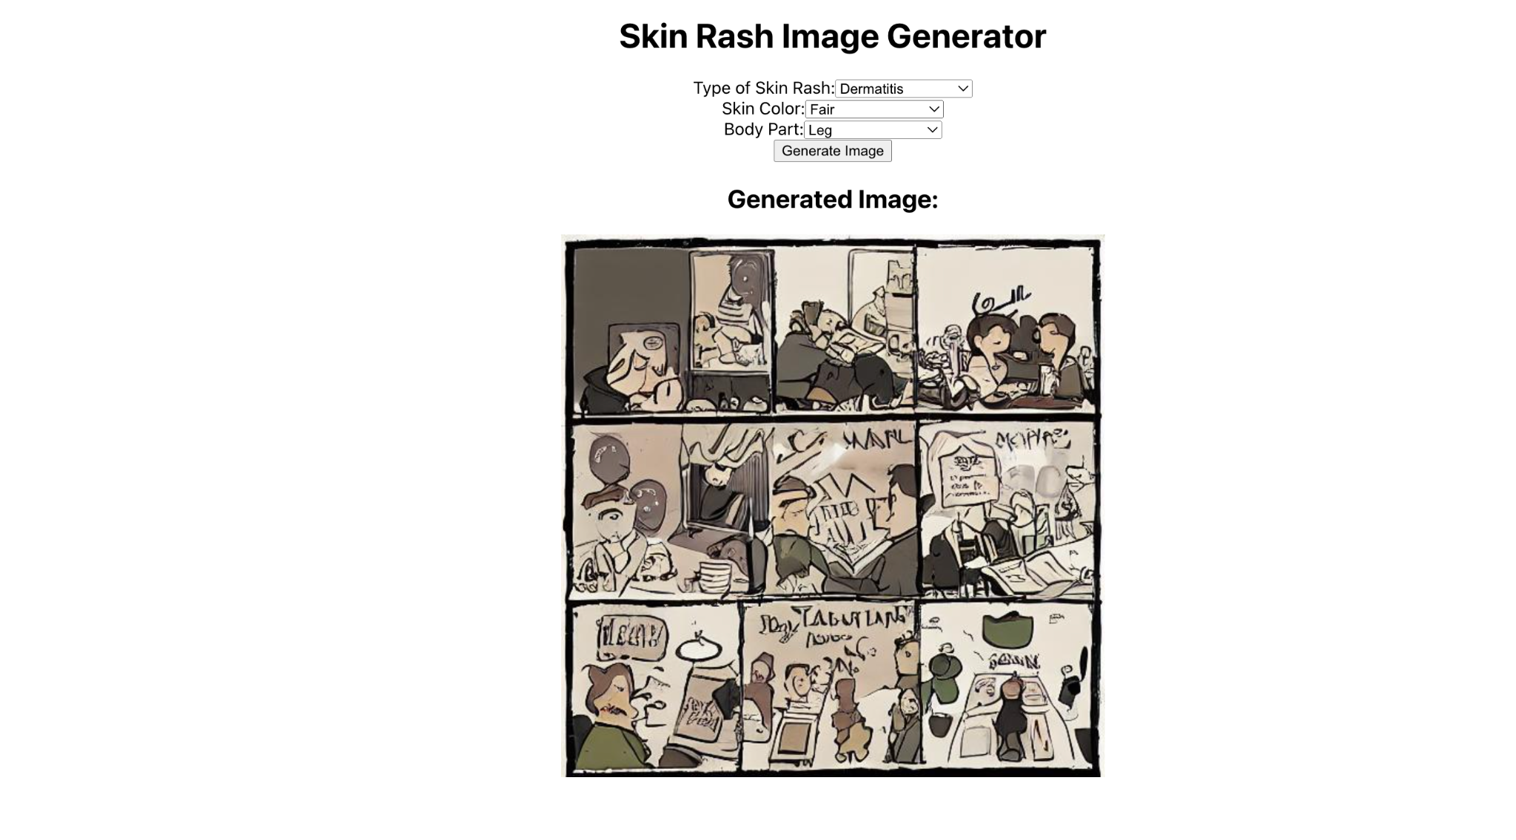
RESULTS AFTER FINE TUNING

Slide 11
FUTURE WORK
Challenges: Data diversity, model accuracy, ethical considerations
Future plans: Expand rash types, improve precision, integrate with educational platforms

Slide 12
Successfully developed a responsive and intelligent travel agent chatbot.
Leveraged cutting-edge technologies including React.js, FastAPI, spaCy, NLTK, and GPT-3.5.
Integrate and test against local-LLMs
Thank you Everyone for your attention and support !!

Slide 13
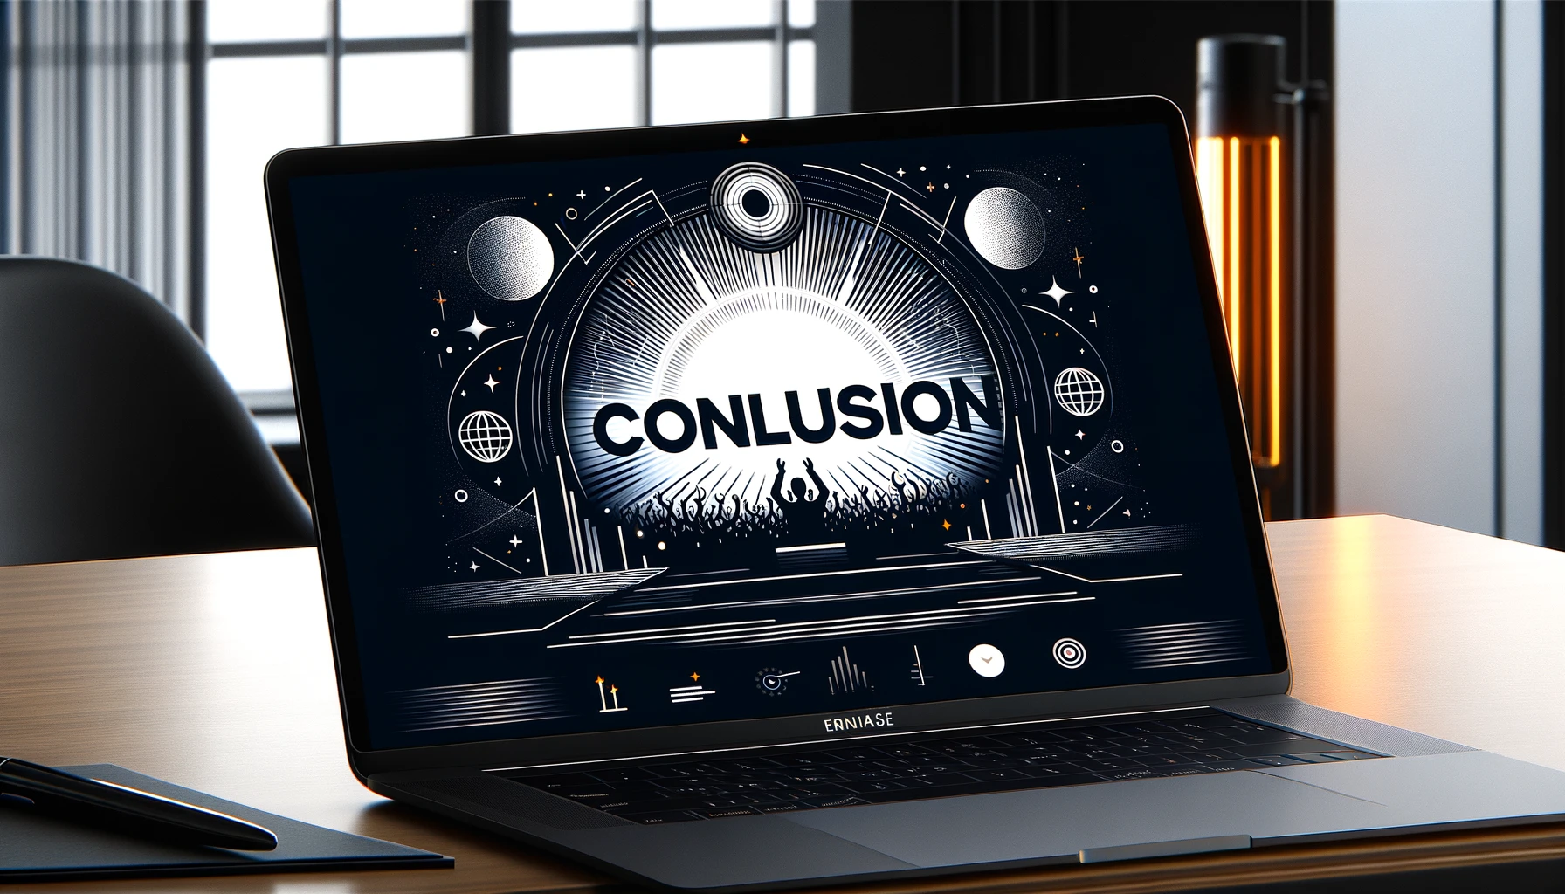
Conclusion and Future Work
Successfully developed a responsive and intelligent travel agent chatbot.
Leveraged cutting-edge technologies including React.js, FastAPI, spaCy, NLTK, and GPT-3.5.
Integrate and test against local-LLMs
Thank you Everyone for your attention and support !!

